Slide 1
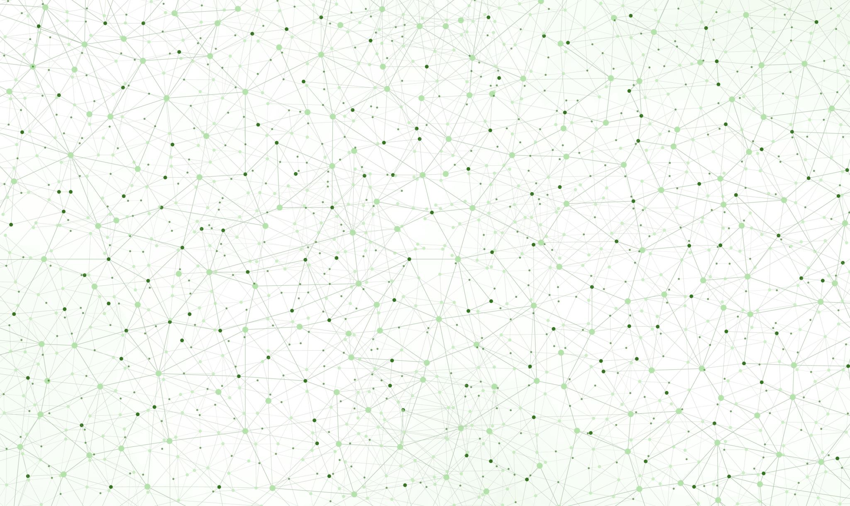
Universal Synthetic Image Detection
Tanvir Mahmud Prince, Eshan Agarwal

Slide 2
Introduction Related Works
- Generative models produce photorealistic fakes indistinguishable from real photos
- Existing detectors overfit to specific generators and lack interpretability
- Objective: universal detector that generalizes across generators, fuses spatial + frequency cues, and explains decisions
- Dataset: FaceForensics++ (real + fakes from Deepfakes, Face2Face, FaceSwap, NeuralTextures)
- Prior work: single-domain CNNs (XceptionNet) and frequency-only methods (FreqNet)
- Key gap: no approach combined both domains with per-sample dynamic weighting and explainability
- Our improvement over initial hypothesis: attention-based fusion outperforms simple concatenation, and Grad-CAM provides artifact localization

Slide 3
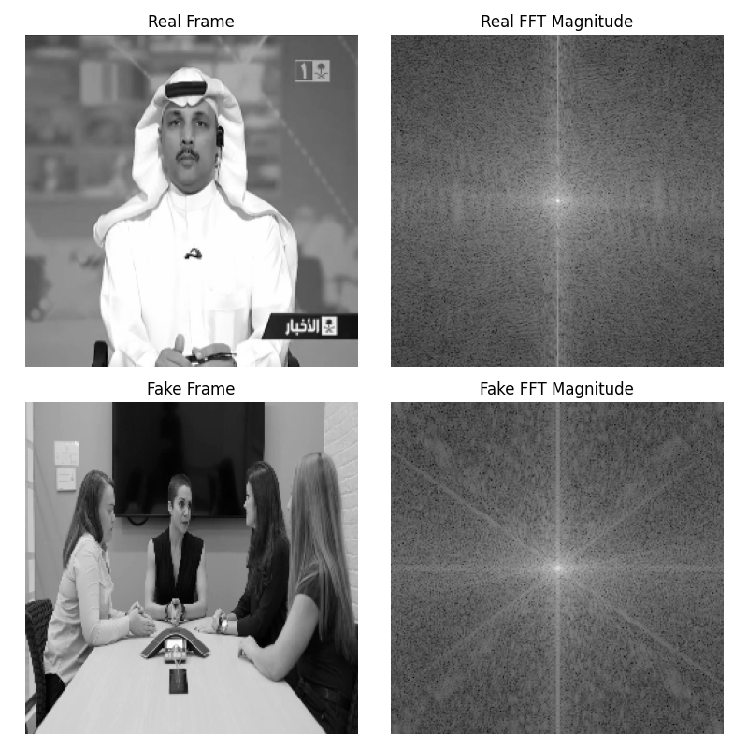
Methodology
Two parallel CNN branches extract features from the same image in two ways:
- Spatial branch (RGB, 3-channel) - captures texture, edge, and color artifacts
- Frequency branch (FFT log-magnitude, 1-channel) - captures periodic artifacts invisible in RGB
Learned attention gate combines both feature vectors:
- A small neural network assigns a weight (0 to 1) to each branch per image
- Dynamically decides which domain matters more for that specific input
- Ex: GAN fakes might show more in frequency, face-swaps more in spatial
Classifier head - fused features pass through an MLP with dropout for final Real vs. Fake prediction
Key advantage: Unlike simple concatenation, attention lets the model adapt per sample, making it robust across different generator types

Slide 4
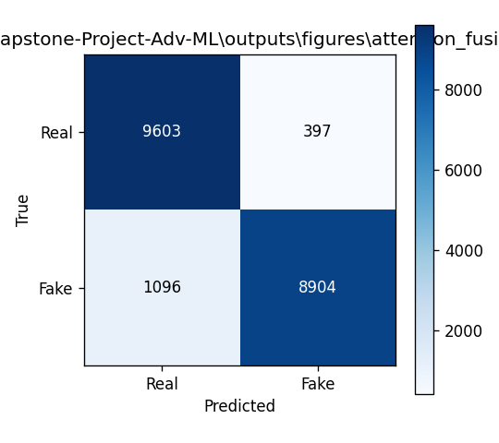
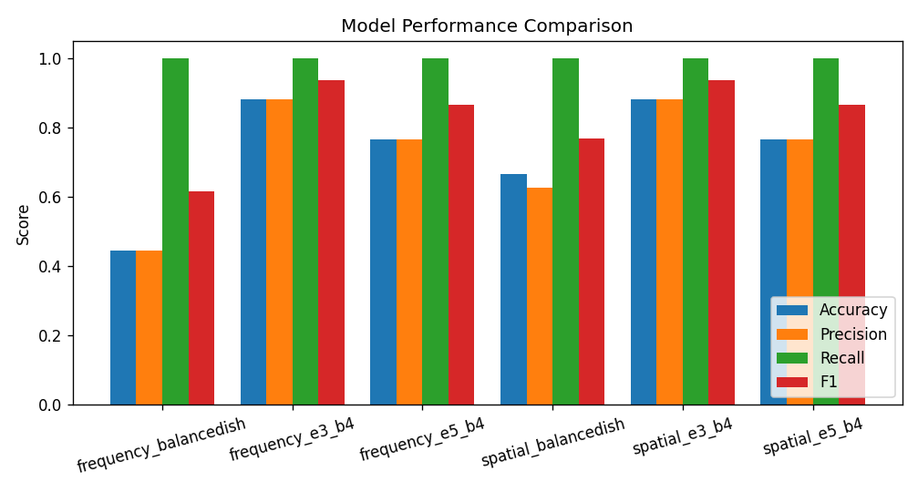
Results
Comparison Metrics Table
Key Takeaways:
- Attention Fusion beats all other models by >7% accuracy
- +18.8% F1 over simple fusion → the attention gate is essential
- Spatial-only: high precision (92%) but misses 1/3 of fakes (67% recall)
- Frequency-only: near chance → spatial is the primary signal, frequency is complementary
Name | Accuracy | Precision | Recall | F1
Spatial | 80.7% | 92.2% | 67.1% | 77.7%
Frequency | 46.5% | 47.3% | 63.4% | 54.2%
Fusion | 68.9% | 67.2% | 73.9% | 70.4%
Attention Fusion | 88.1% | 86.0% | 91.1% | 88.5%

Slide 5
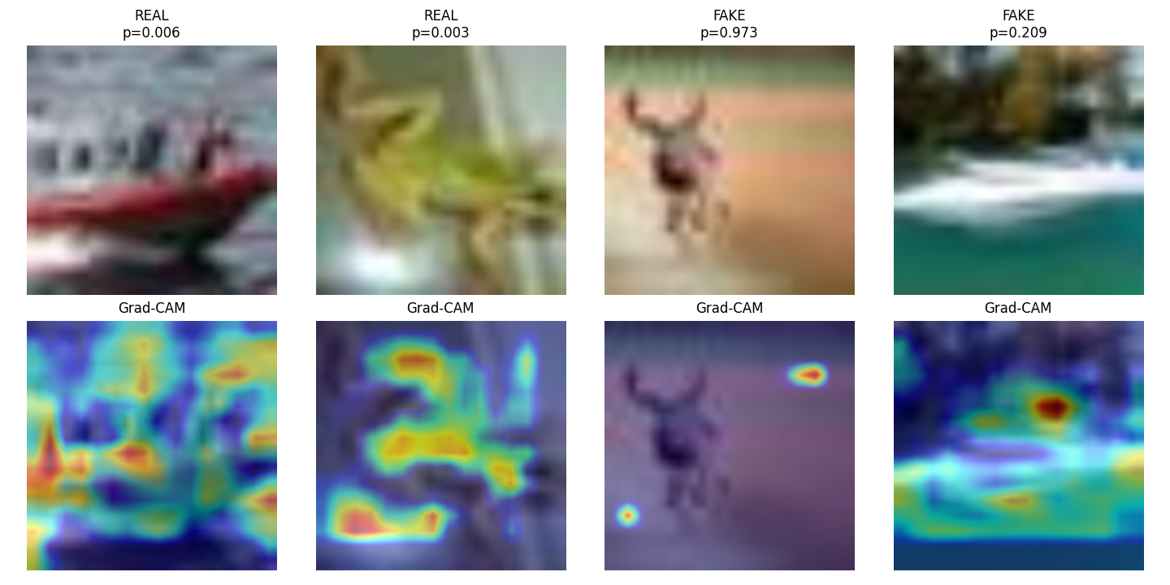
Discussion and Conclusion
Contributions
1. Learnable Attention Fusion - dynamic per-sample weighting of spatial vs. frequency features (not static concatenation)
2. Explainable AI - Grad-CAM heatmaps localize artifacts for forensics interpretability
3. Universal Detection - generalizes across 5 generative methods without per-generator tuning
Key Insights
- Spatial features dominate detection for most fake images
- Frequency domain provides decisive cues in edge cases (Ex: high-quality GAN outputs)
- The attention mechanism reliably weights the frequency branch higher when the spatial branch is uncertain
Limitations
- Trained only on FaceForensics++ - limited generator diversity
- Frame-by-frame only - no video-level temporal consistency analysis
Future Work
- Expand training across diverse generators (DALL-E, Midjourney, Stable Diffusion)
- Incorporate temporal analysis for video deepfake detection
Conclusion
Attention-based multi-domain fusion is an effective, explainable approach for universal synthetic image detection, achieving 88.1% accuracy with per-sample Grad-CAM interpretability.

